Slide 1
Deep Learning in TensorFlow
Caleb Moses
Notes:
Possibly useful: 50 Years of Data Science
http://courses.csail.mit.edu/18.337/2015/docs/50YearsDataScience.pdf
Machine Ethics presentation:
https://youtu.be/hDgXIUM3Rmw?t=34m37s
I pulled this together inside of a week, and I’m glad I didn’t have more time because then I would have even more to say!
DISCLAIMER: This is a very ambitious talk – Please ask lots of questions (and interrupt sooner rather than later) if you are confused. I’ll try to make regular stops to check that people are following.
I am committed to the idea that I won’t make it through all of this

Slide 2
Overview
Machine Learning
Neural Networks and Deep Learning
Intro to TensorFlow
Reading Digits from 0-9

Slide 3


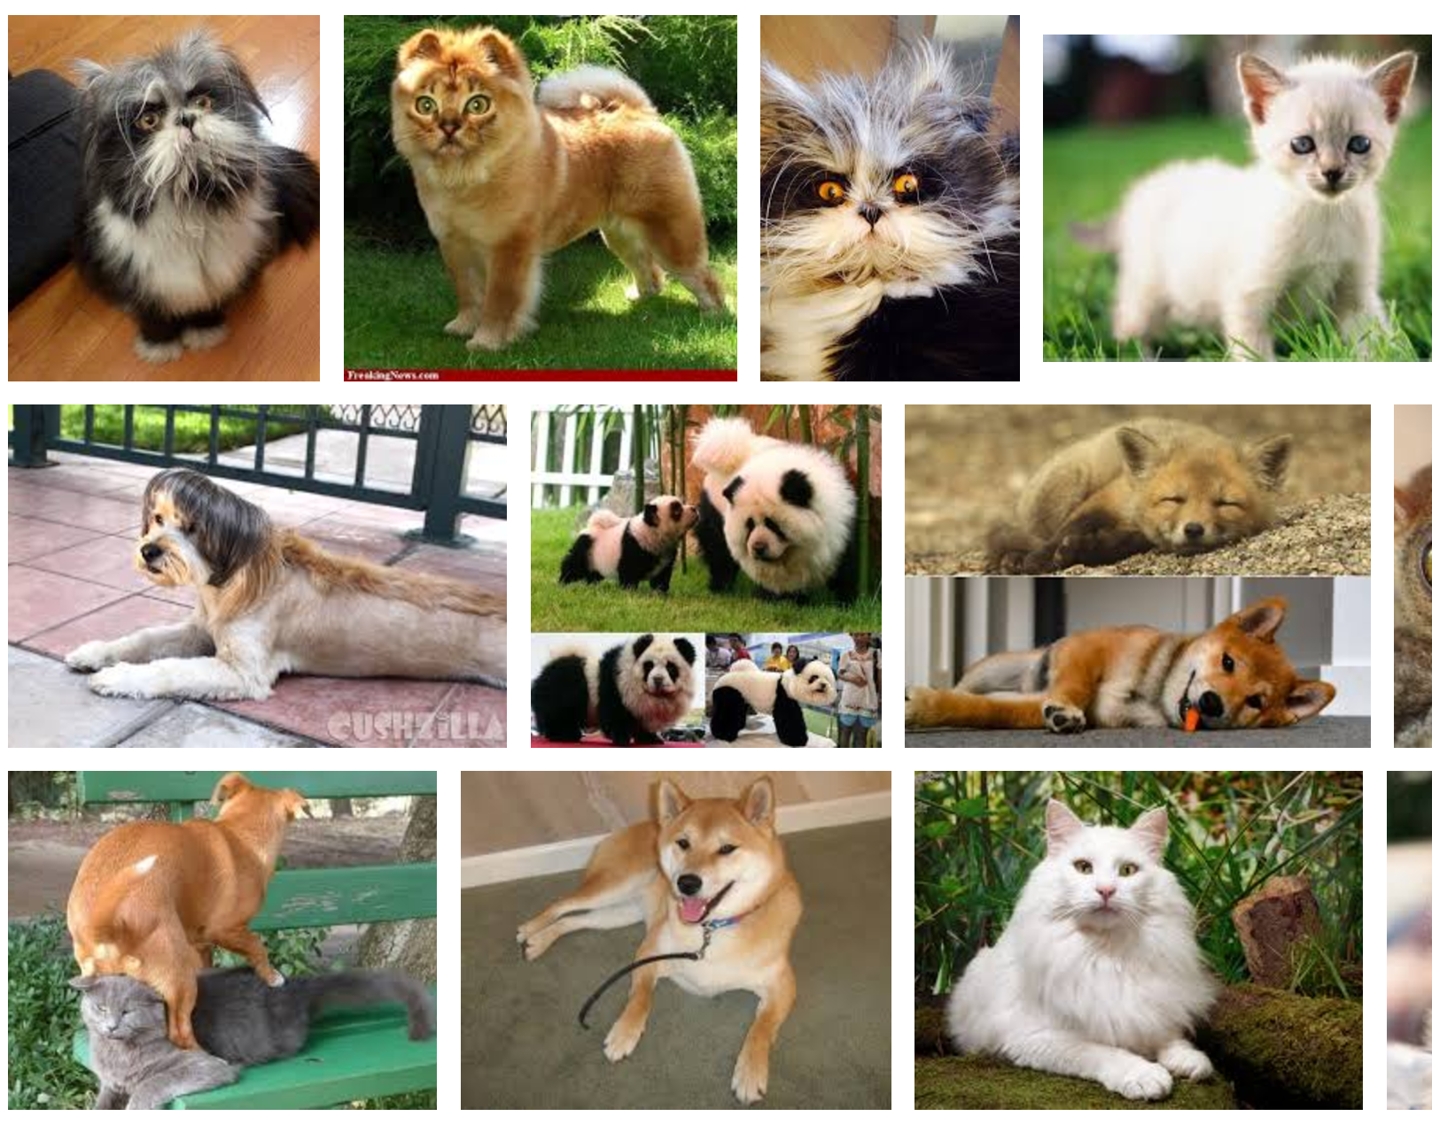
How a human learns
Imagine we are trying to teach a baby how to tell a cat from a dog
Notes:
(Can improve this slide)
I might be about to expose my ignorance, because I am not a parent – so bear with me
You show the child a bunch of examples, and continually evaluate its progress
Eventually they might hit a block. Usually this happens with a new example doesn’t line up with the concept that the child has formed in their mind. In this case, they can make a mistake – but this is an opportunity to *learn* something new.

Slide 4
How a human learns
A typical approach might look like this:
Teach fundamental principles
Show by example
Evaluate progress with a test
Notes:
Fundamental principles include fur, colour, long/short tails, pointy ears
Show examples and have the child make guesses – let them know if they were right or wrong
Evaluate with test – in the test, include pictures the child hasn’t seen before

Slide 5
How a machine learns
Similar, but more rigorous
Collect many examples
Hide some of these from the computer and use the rest to teach
After teaching the computer first, use the hidden data to find the true accuracy of the model
Notes:
In machine learning, we approach the problem of teaching the computer in much the same way with some added mathematical rigor
(kinda rough, but it’ll do for now)

Slide 6
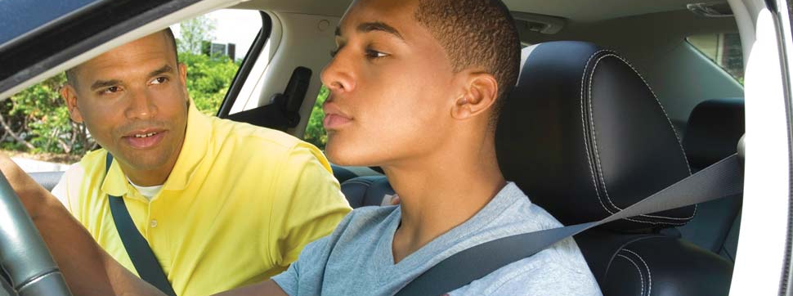
Supervised Learning
Notes:
Supervised learning = when you have labelled training data
https://www.twitch.tv/sentdex

Slide 7

Unsupervised Learning
Notes:
Unsupervised Learning = when you have unlabelled training data
Examples include clustering of various kinds – can be tough to get working well
T-SNE clustering example: https://cs.stanford.edu/people/karpathy/cnnembed/cnn_embed_6k.jpg

Slide 8

Reinforcement Learning
Notes:
Unsupervised Learning = when you have unlabelled training data
Examples include clustering of various kinds
MarI/O video: https://www.youtube.com/watch?v=qv6UVOQ0F44

Slide 9
The Machine Learning Model
Training Data
Evaluation Function
ValidationStep
Learning Model
Notes:
In supervised learning, the training data is ‘labelled’ with information that can be used for evaluation
In unsupervised learning, the evaluation step is performed using a general principle that doesn’t require looking at the true values in the data
In reinforcement learning, the evaluation step is extracted from a system that rewards or penalises the learning algorithm on the fly
- So how do we perform the learning task? This is done using a model.

Slide 10
Intro to Neural Networks:
A Neural Network is but one example of a learning model – there are many others
Neural Networks are ‘loosely’ modelled after the connections of the human brain
It is particularly suited to image + sequential data including language processing and time series
Notes:
NB: Each neuron in the human brain is a complex dynamical system. The ‘Artificial Neural Network’ (so-called) is a big simplification of the actual brain.

Slide 11
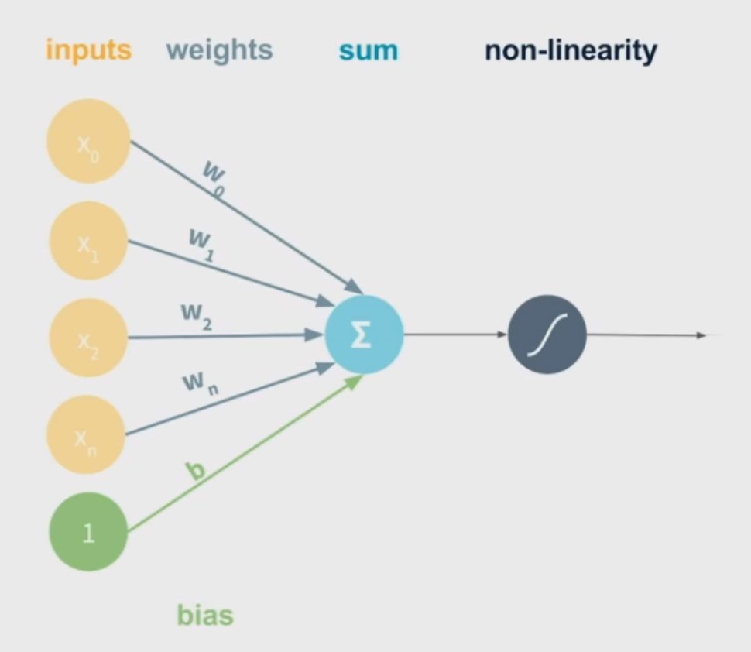
The Single Neuron
Notes:
This is what a Neural Network looks like
Also called a ‘perceptron’ – think on-off switch
Inputs are numbers, weights are numbers – take inner product and squash with non-linearity

Slide 12
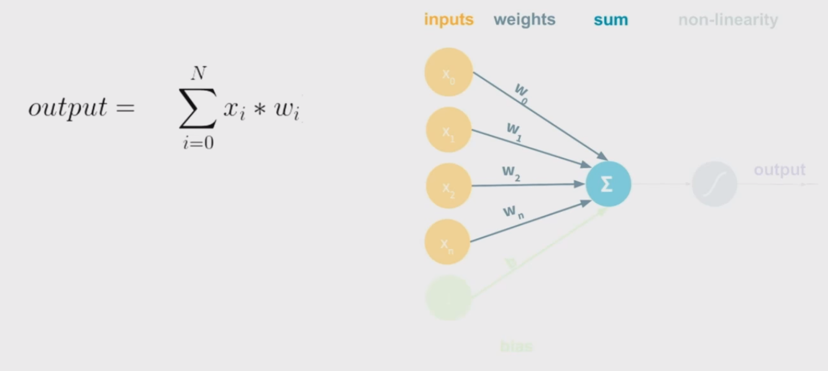
The Single Neuron
Notes:
The inputs are combined with the weights via a dot product

Slide 13
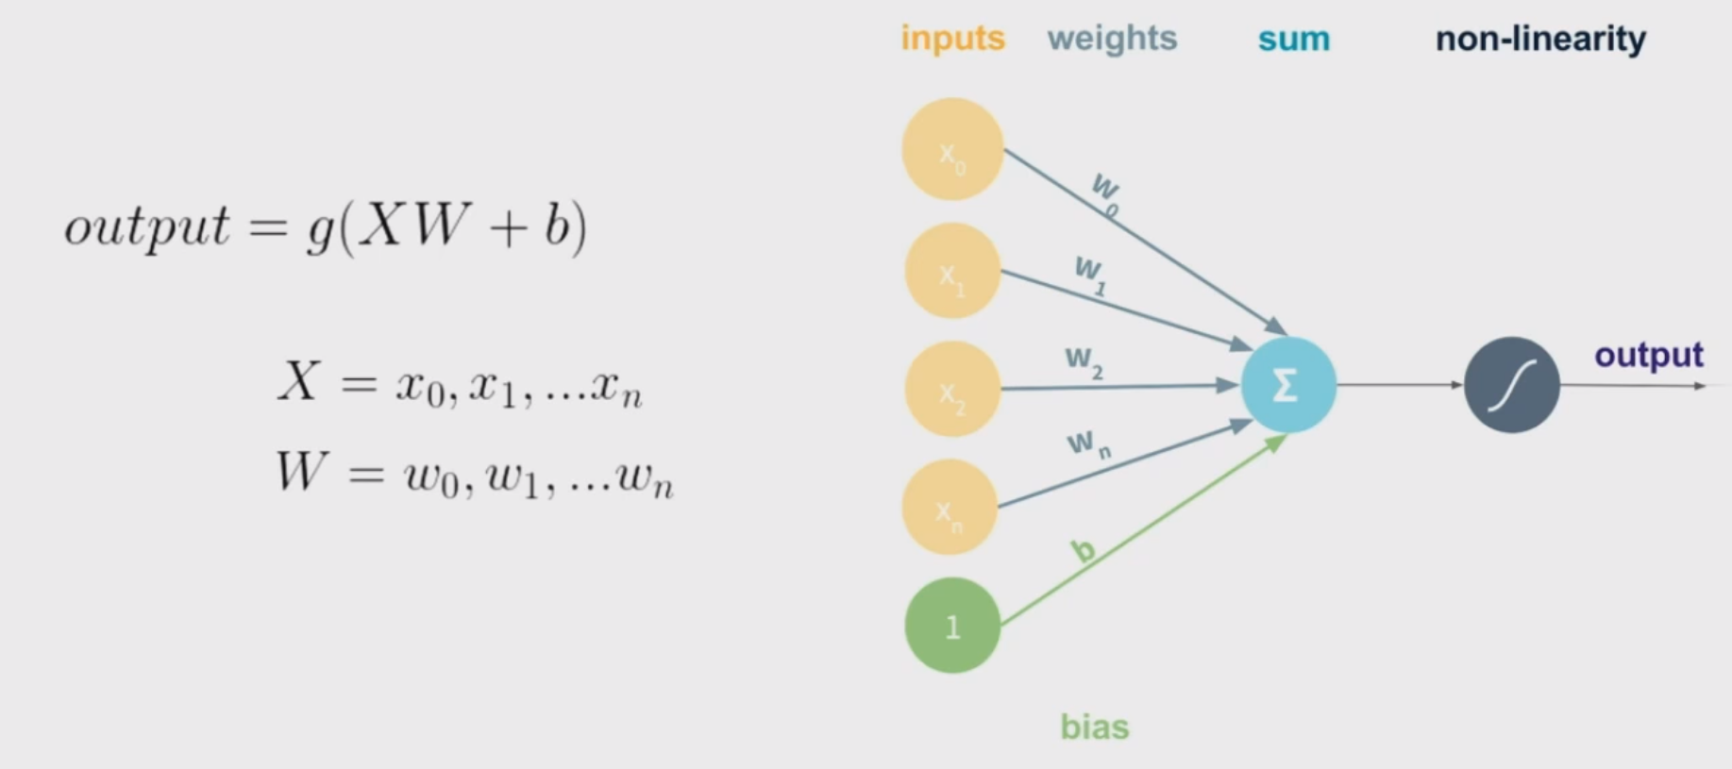
The Single Neuron
Notes:
The weighted sum of the inputs is run through a non-linear function called an ‘activation

Slide 14
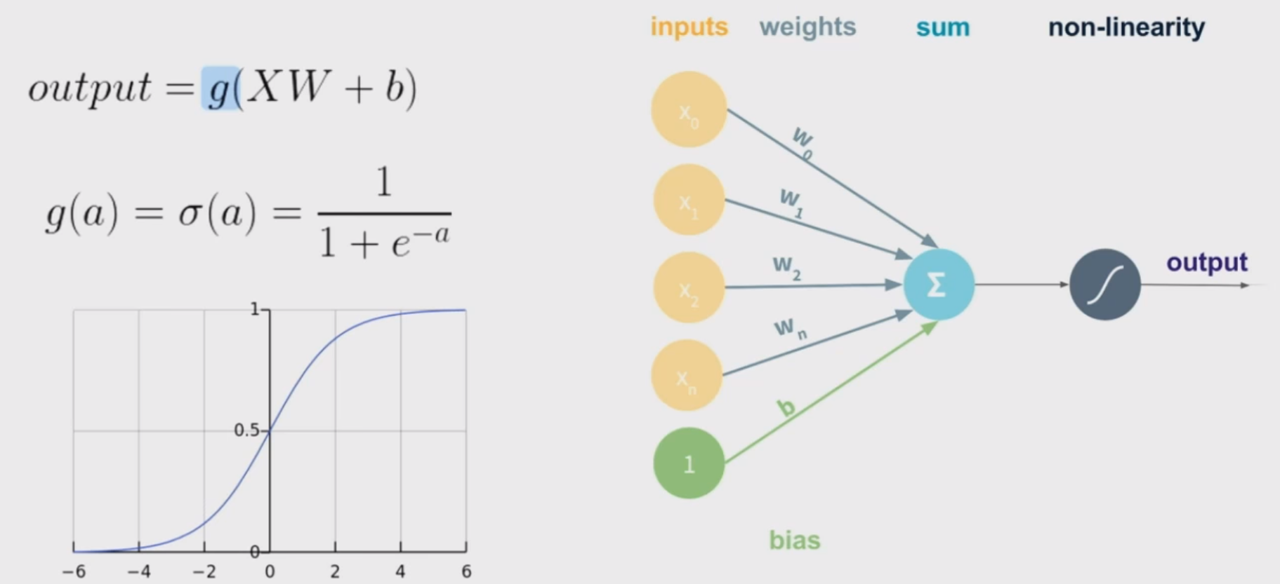
Activation Function
Notes:
Activation functions come in many types, but they are all non-linear and continuous. They are not all smooth, however.
Note the sigmoid function expression (this shows up on the next slide)

Slide 15
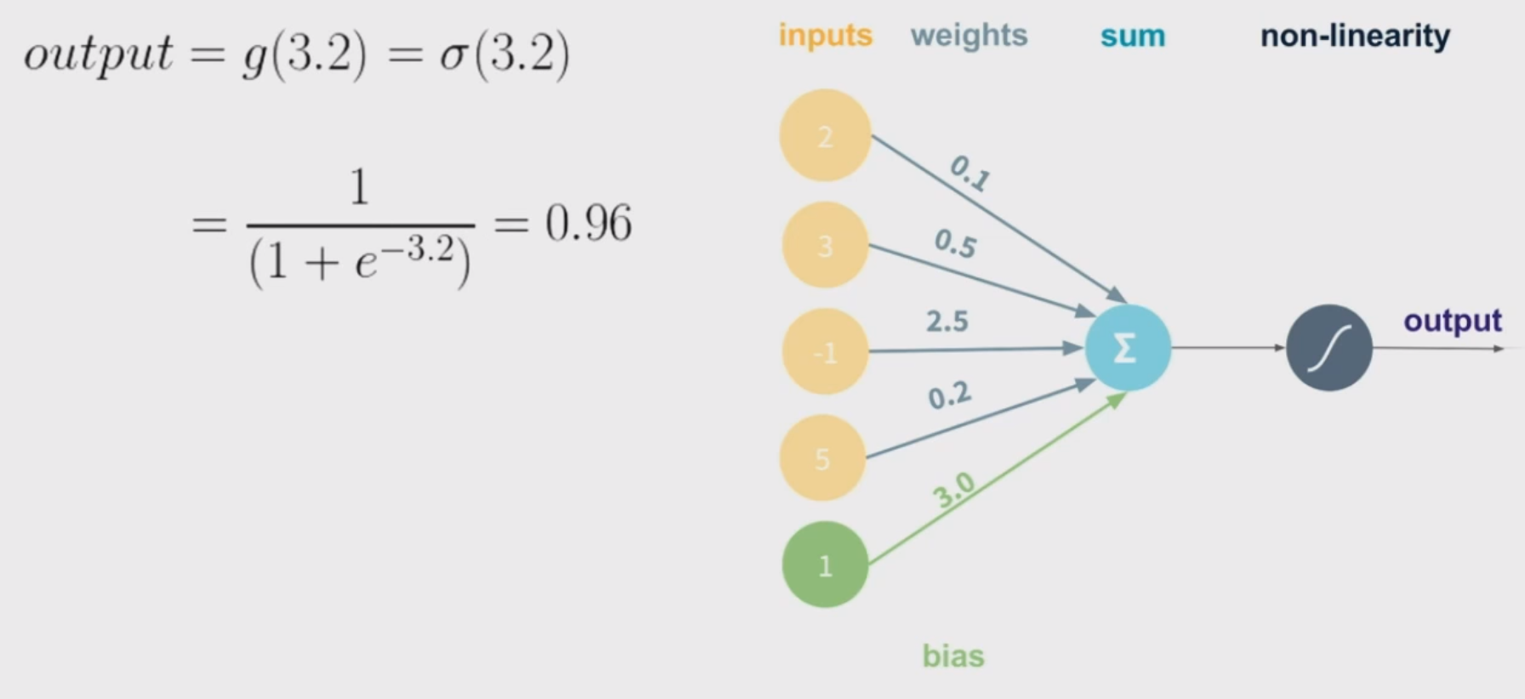
Example Calculation
Notes:
Here is an example calculation

Slide 16
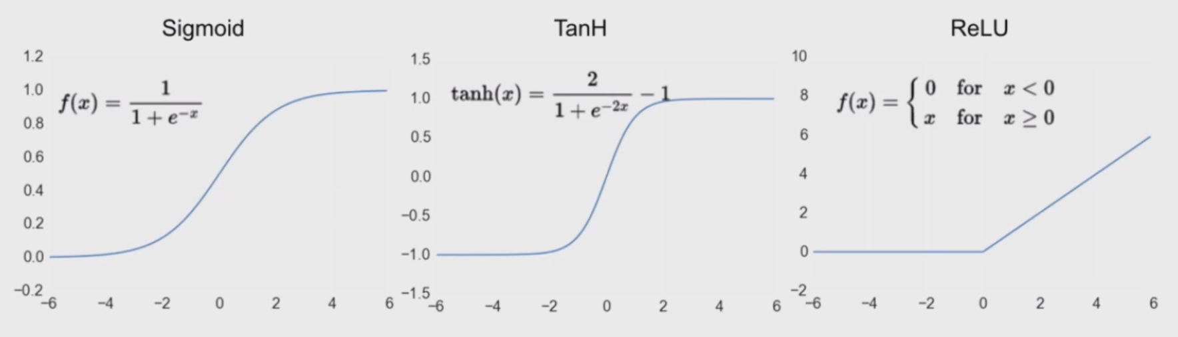
Common Activation Functions
Notes:
Here are some other activation functions – these are the most common, but there are others (which tend to be considerably more complex)

Slide 17
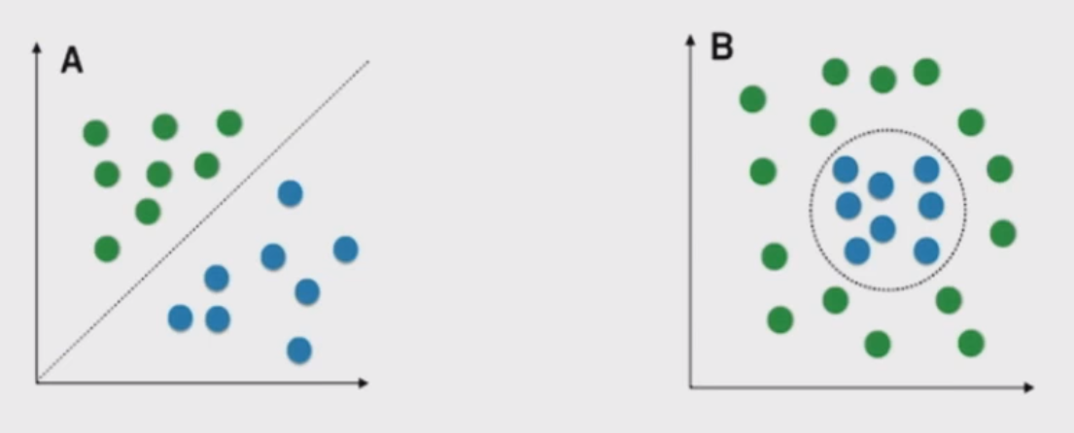
Why Use Nonlinear Activation Functions?
Notes:
A decision boundary is the set of points on which the model is indifferent between each of the categories.
Non-linear activation functions give non-linear decision boundaries.

Slide 18

Multiple Outputs are Possible
Notes:
For two outputs, you double the weights

Slide 19
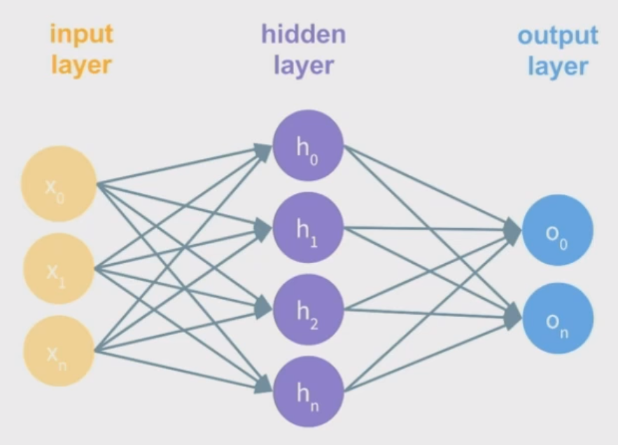
Hidden Layers are Useful
Notes:
The hidden layer concept is key.

Slide 20
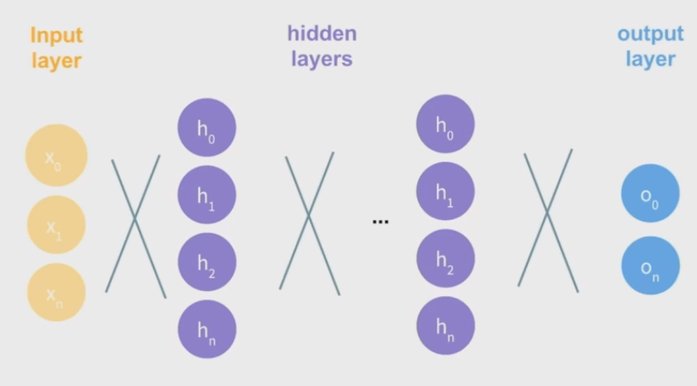
Multiple Hidden Layers = Deep Learning
Notes:
ASK FOR QUESTIONS HERE
Hidden layers can be stacked, with the output of each layer becoming the input of the next – all the way to the output
This is called Deep Learning
Step into http://playground.tensorflow.org

Slide 21

Neural Networks are like Lego
The parts are:
Activation functions
Layer types
Architectures
The weights and biases are the parameters of the model
Notes:
Layer types can get considerably more complicated – especially in image and sequence processing
I have only shown a simple example

Slide 22
How to train?
Deep Learning models are trained via a process called backpropagation
A loss function assesses the performance of the model on sample data
Overfitting is an issue
Notes:
Backpropagation – compute derivatives of the loss at the forward layers, and propagate back to the input layer
Update the values of the weights to improve the accuracy of the prediction next time
Explain overfitting
Step into http://playground.tensorflow.org

Slide 23
Rationale For Deep Learning
Modular
Highly parallelisable
Backpropagation works for layered networks
They work pretty well
Notes:
This is called Deep Learning
Step into http://playground.tensorflow.org

Slide 24
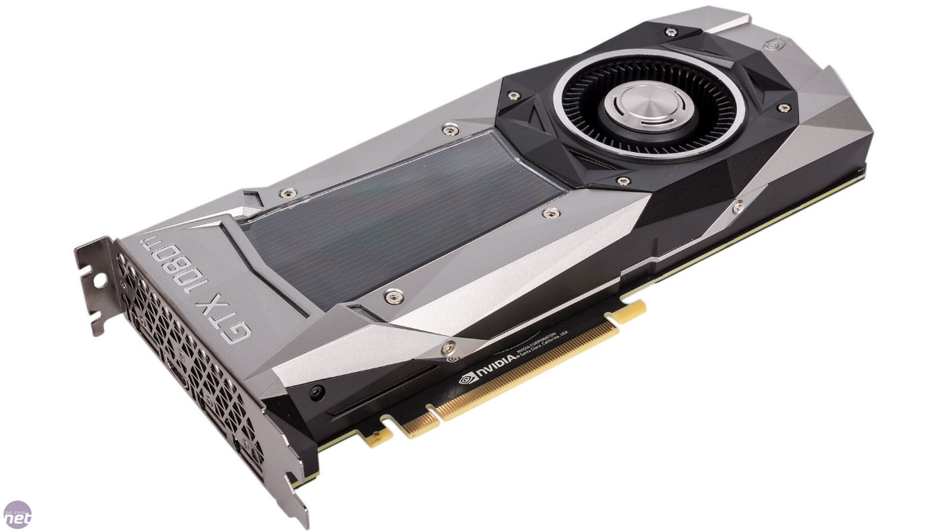
Downsides of Deep Learning
Very data hungry
Produce a black box
Labelled training is still the best
Computationally intensive: large models require parallelisation + GPU power
Notes:
GPU power might not be a problem in the cloud computing model. If you have a cluster at your disposal, even better!
Also parallelised CPU power can train ‘decent-ish’ networks, just slower
Step into http://playground.tensorflow.org

Slide 25
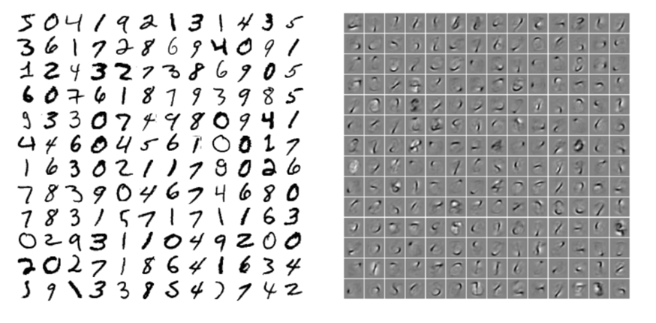
Representations
Notes:
This is called Deep Learning
Step into http://playground.tensorflow.org

Slide 26
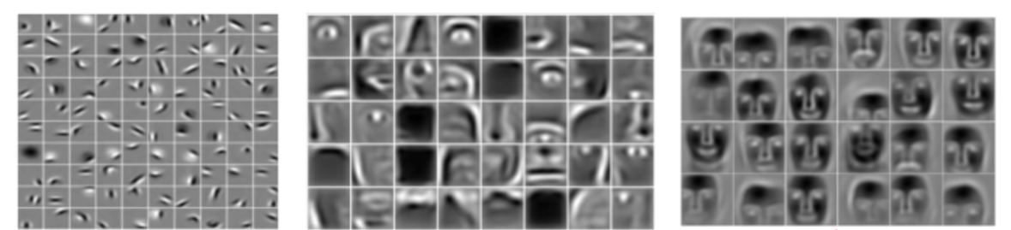
Representations
Notes:
This is called Deep Learning
Step into http://playground.tensorflow.org

Slide 27
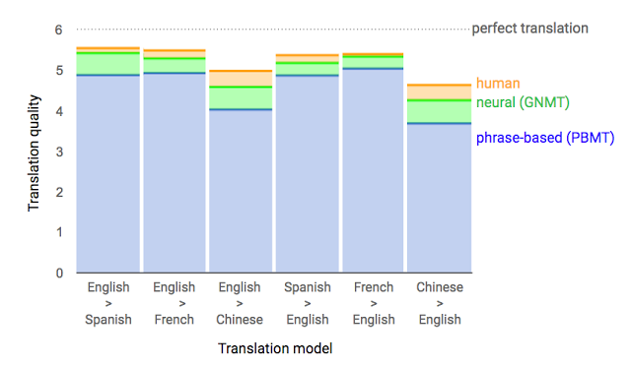
Machine Translation
From a paper titled: “Google’s Neural Machine Translation System: Bridging the Gap between Human and Machine Translation”
Notes:
Neural Networks also have uses in Time series data

Slide 28
Applications
Deep Learning is considered the state of the art in many data processing tasks including:
Natural Language Processing
Machine Vision
Recommendation algorithms
Notes:
In NLP Deep Learning is used for: Machine Translation, Text Mining/Parsing, Speech to text/Text to speech etc
Cool paper: https://arxiv.org/pdf/1609.08144.pdf (Google LSTM Translation)
In Machine Vision, Deep Learning is used for Self-Driving Cars, Object Detection etc, Image Captioning, lots of stuff
Deep Learning forms the backbone for the youtube recommendation engine, and probably many others
It can also be used for time series and other sequential data

Slide 29
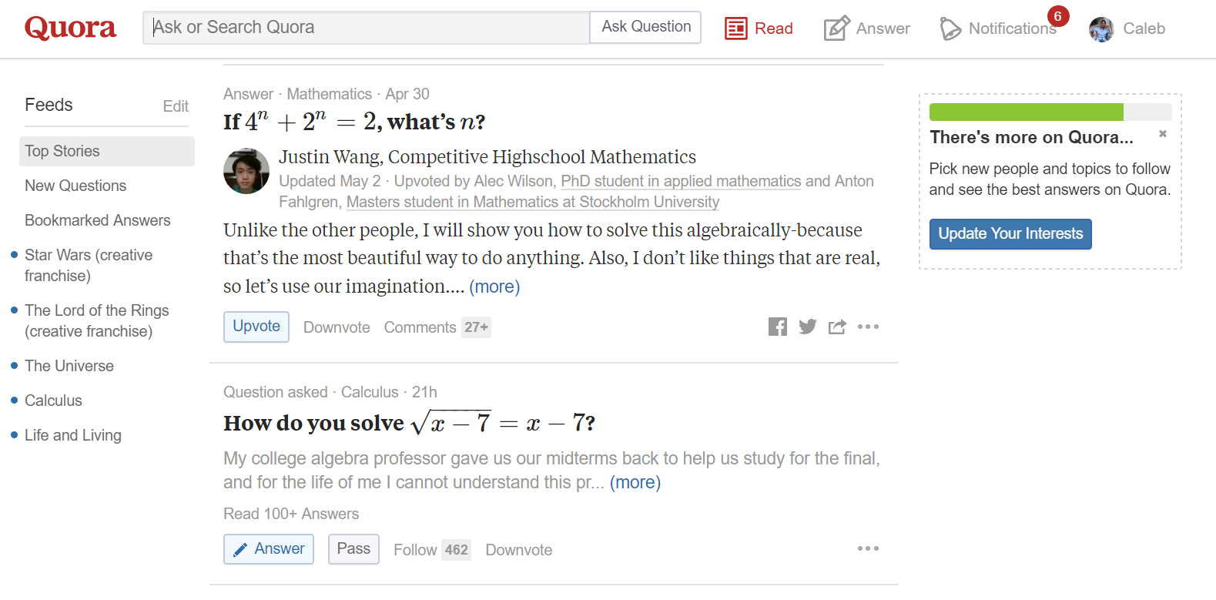
Quora.com
Notes:
In case you don’t know what Quora is:
Quora Text Similarity
https://demos.explosion.ai/similarity/?text1=This%20is%20another%20sentence&text2=How%20fast%20can%20a%20swallow%20eat%3F

Slide 30
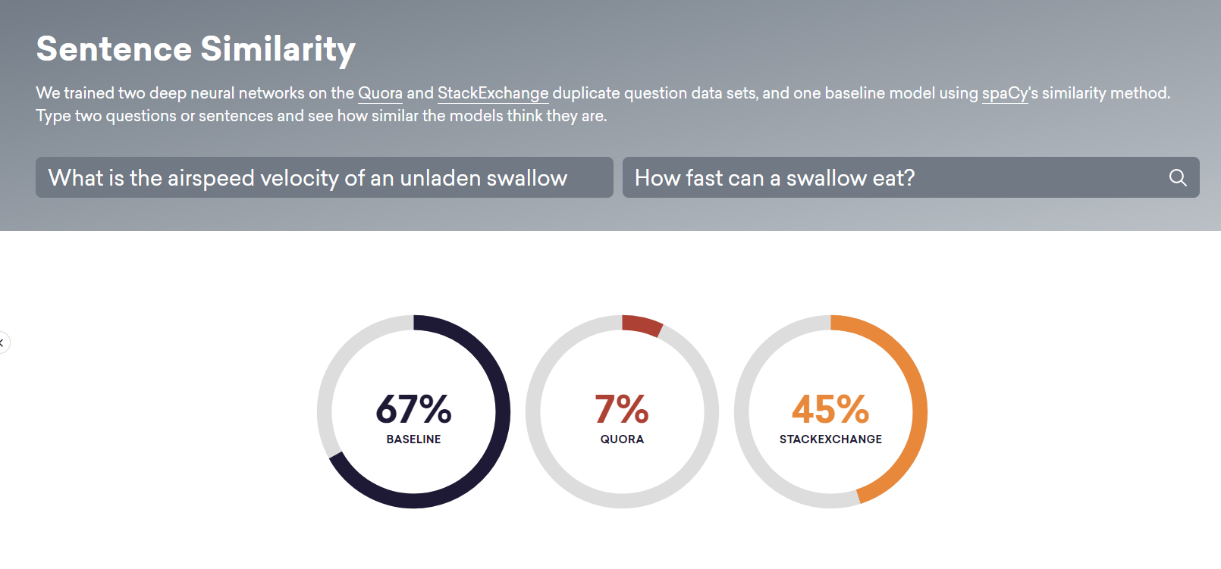
Text Deduplication
Notes:
Quora Text Similarity
https://demos.explosion.ai/similarity/?text1=This%20is%20another%20sentence&text2=How%20fast%20can%20a%20swallow%20eat%3F

Slide 31
Synthetic Shakespeare
PANDARUS:
Alas, I think he shall be come approached and the day
When little srain would be attain'd into being never fed,
And who is but a chain and subjects of his death,
I should not sleep.
Second Senator:
They are away this miseries, produced upon my soul,
Breaking and strongly should be buried, when I perish
The earth and thoughts of many states.
Notes:
Generated one character at a time

Slide 32
Synthetic Baby Names
Rudi, Levette, Berice, Lussa, Hany, Mareanne, Chrestina, Carissy, Marylen, Hammine, Janye, Marlise, Jacacrie, Hendred, Romand, Charienna, Nenotto, Ette, Dorane, Wallen, Marly, Darine, Salina, Elvyn, Ersia, Maralena, Minoria, Ellia, Charmin, Antley, Nerille, Chelon, Walmor, Evena, Jeryly, Stachon, Charisa, Allisa, Anatha, Cathanie, Geetra, Alexie, Jerin, Cassen, Herbett, Cossie, Velen, Daurenge, Robester, Shermond, Terisa, Licia, Roselen, Ferine, Jayn, Lusine, Charyanne, Sales, Sanny, Resa, Wallon, Martine, Merus, Jelen, Candica, Wallin, Tel, Rachene, Tarine, Ozila, Ketia, Shanne, Arnande, Karella, Roselina, Alessia, Chasty
Notes:
Generated one character at a time

Slide 33
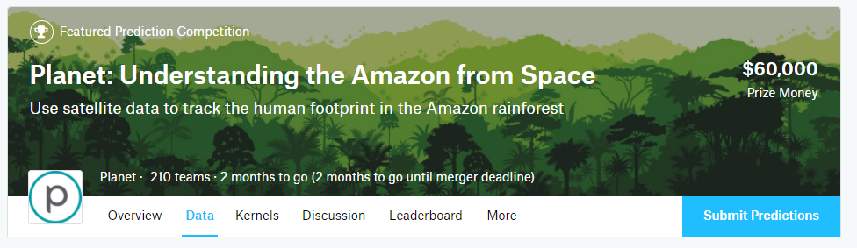
Machine Vision
Notes:
Link to competition
https://www.kaggle.com/c/planet-understanding-the-amazon-from-space/data

Slide 34
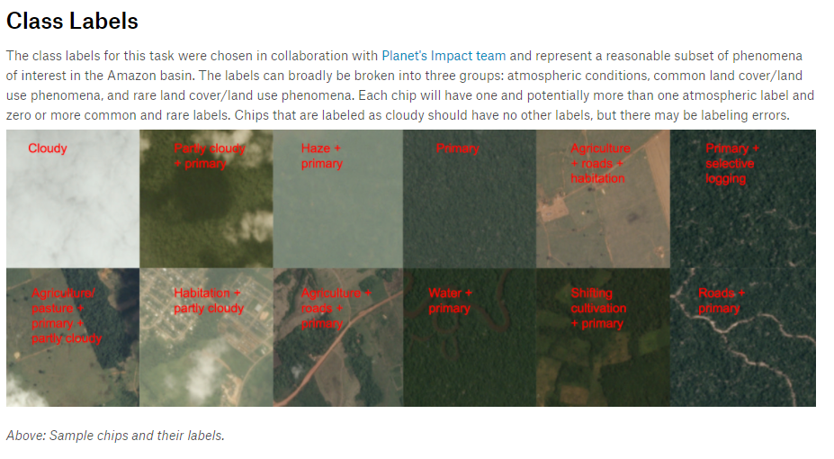
Machine Vision
Notes:
Link to competition
https://www.kaggle.com/c/planet-understanding-the-amazon-from-space/data

Slide 35
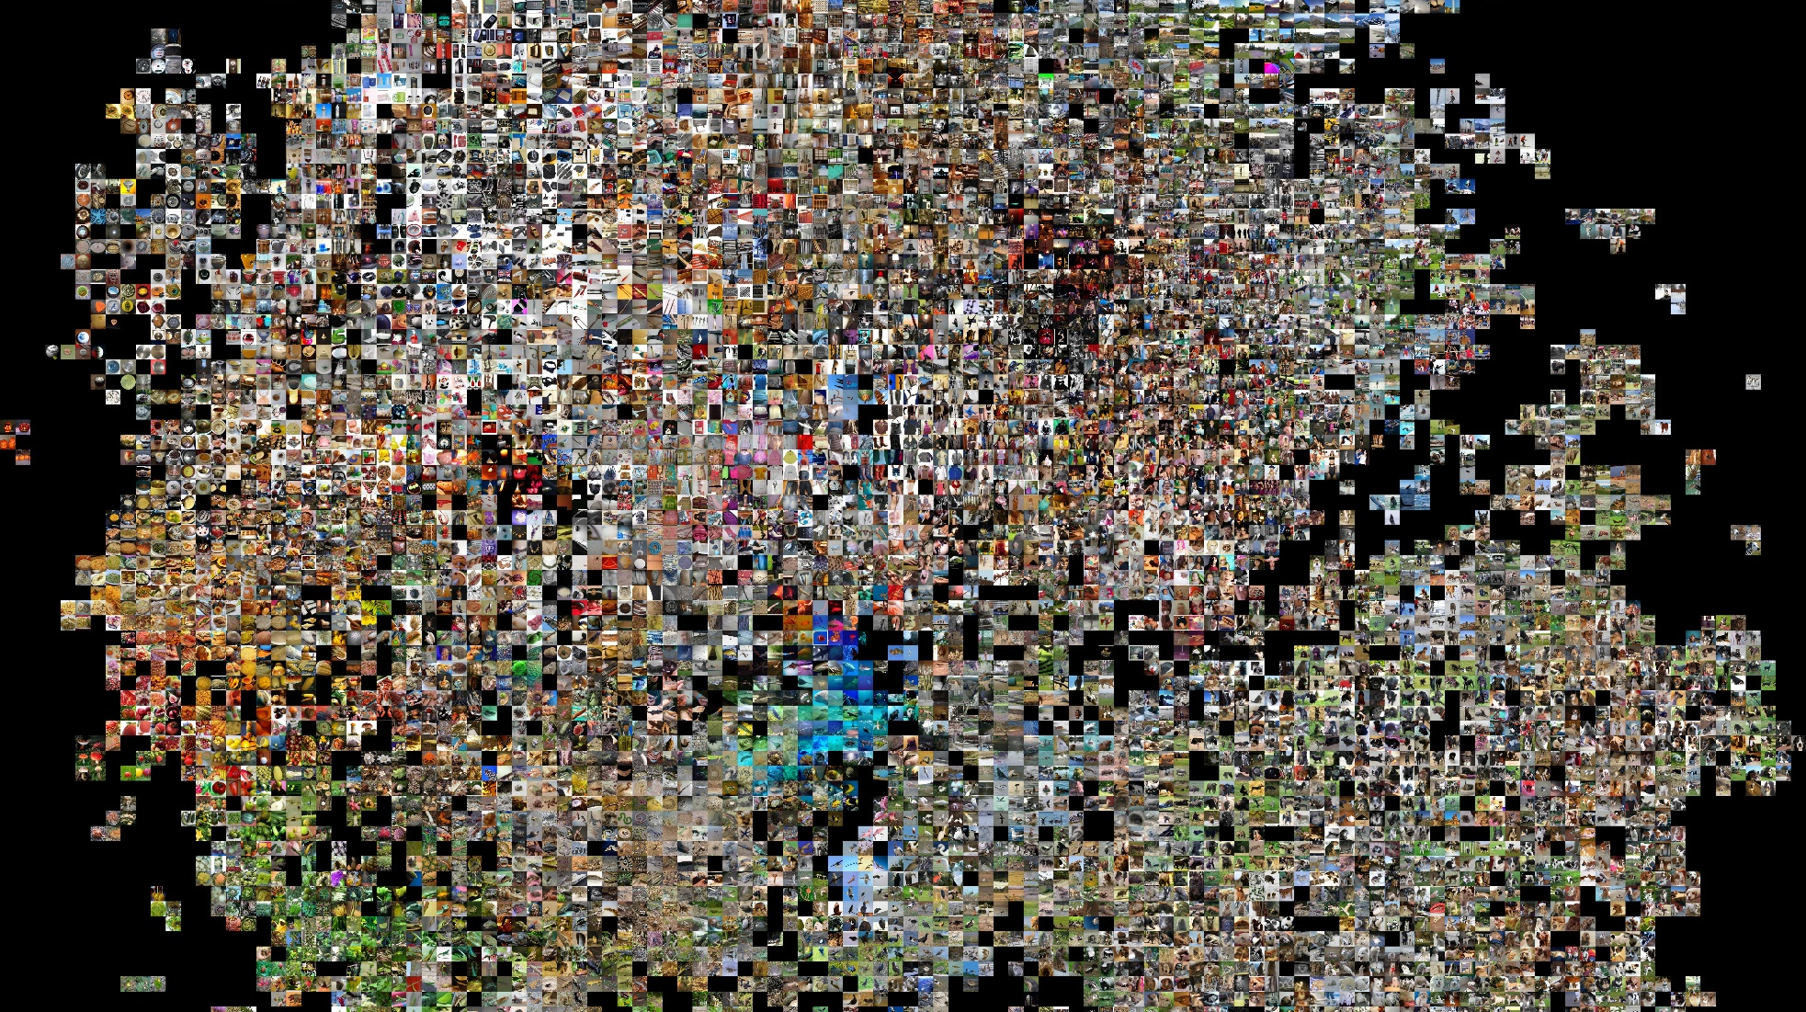
Machine Vision
Notes:
ImageNet –
ImageNet is an image dataset. A collection of tens of millions of images, each tagged with text describing the image contents
Link to live image captioning
https://www.youtube.com/watch?v=VH8dvaxI9j8&t=1236s
Comparing human performance to a Convolutional Neural Network
https://karpathy.github.io/2014/09/02/what-i-learned-from-competing-against-a-convnet-on-imagenet/

Slide 36

Recommendation Algorithms
Notes:
https://static.googleusercontent.com/media/research.google.com/en//pubs/archive/45530.pdf

Slide 37
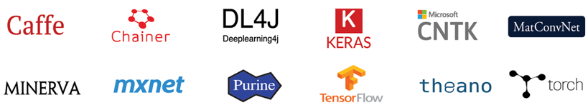
Deep Learning Frameworks
Notes:
Explain why you need a deep learning API:
- To make the most use of parallelism + a GPU if you need one
- Some frameworks provide useful debugging tools (e.g. Tensorboard)
- Deep Learning Models are tedious to write from scratch and highly error prone
For R users, I’ve heard Keras is also popular – Keras is at a higher level than TensorFlow
I used a library called TFLearn in place of Keras to make the coding easier
Noteworthy are: Caffe, Tensorflow, Theano, Keras and also CNTK

Slide 38

TensorFlow
Notes:
But I will be using Tensorflow:
it’s by Google
It’s native to Python
Also has an API for R including everything that I’ve run minus TFLearn
I’ve tried to install it on a session in the R server, but it didn’t work (I’m not an expert so I just gave up)
Live demonstration

Slide 39
In Case the Code Doesn’t Work…

Slide 40
The MNIST Dataset
MNIST is a database of handwritten digits, each labelled with the written value
MNIST was built by the National Institute of Standards and Technology (NIST)
The MNIST database is widely used for training and testing in Machine Learning – it is the ‘hello world’ of image processing problems
Notes:
But I will be using Tensorflow:
it’s by Google
It’s native to Python
Also has an API for R including everything that I’ve run minus TFLearn
I’ve tried to install it on a session in the R server, but it didn’t work (I’m not an expert so I just gave up)
Live demonstration

Slide 41
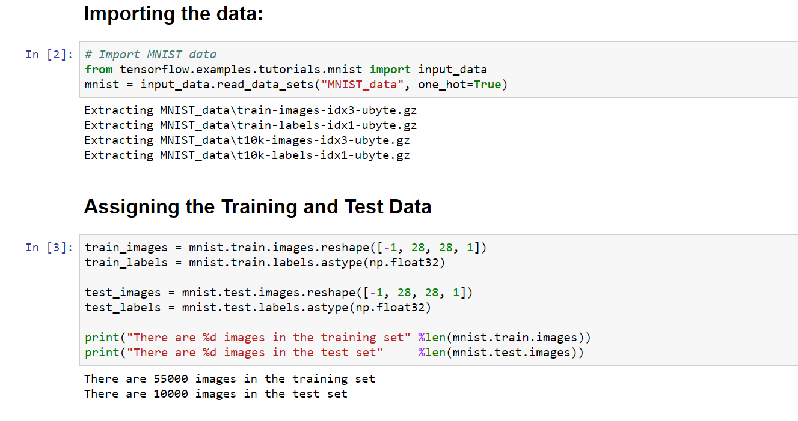
Notes:
But I will be using Tensorflow:
it’s by Google
It’s native to Python
Also has an API for R including everything that I’ve run minus TFLearn
I’ve tried to install it on a session in the R server, but it didn’t work (I’m not an expert so I just gave up)
Live demonstration

Slide 42
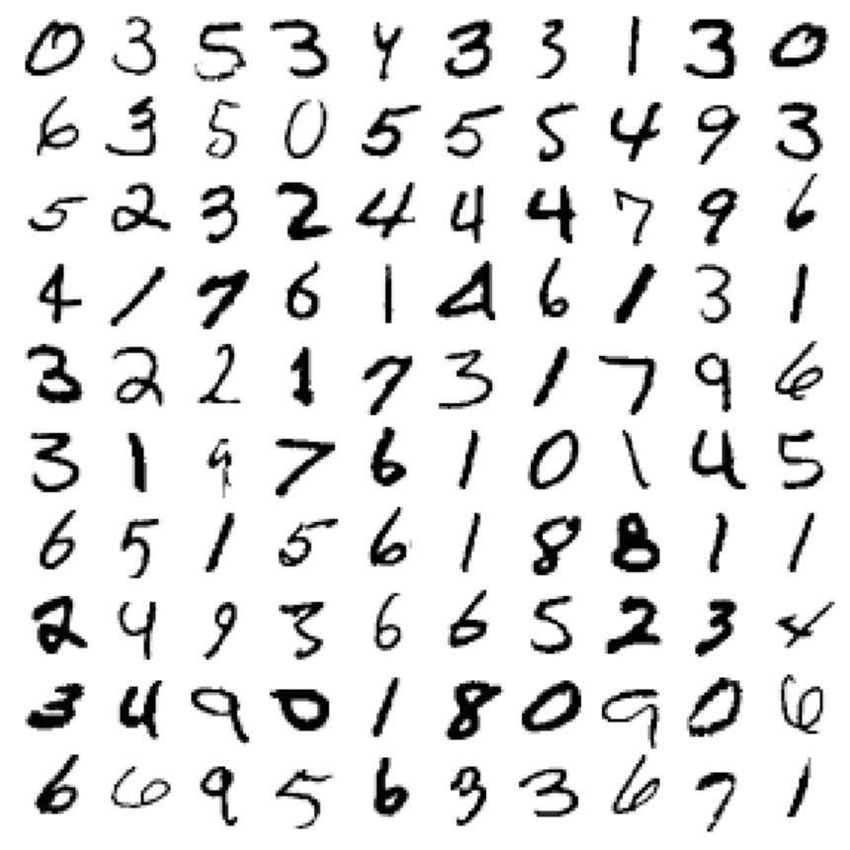
Notes:
A sample of the images – each image is 28x28 pixels, with pixel values that range from 0 to 1

Slide 43
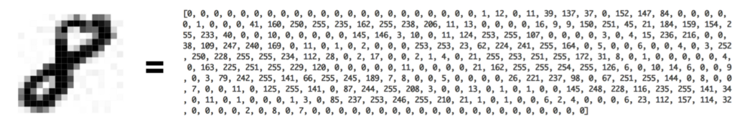
Notes:
Not exactly true – under the hood in my example the values are scaled between 0 and 1 but you get the idea

Slide 44
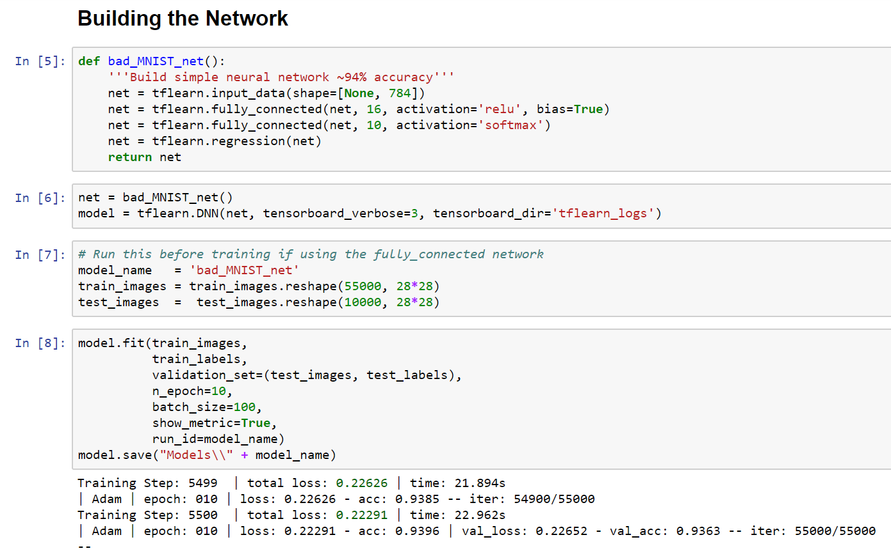
Notes:
A sample of the images – each image is 28x28 pixels, with pixel values that range from 0 to 1
Talk about computational graph

Slide 45
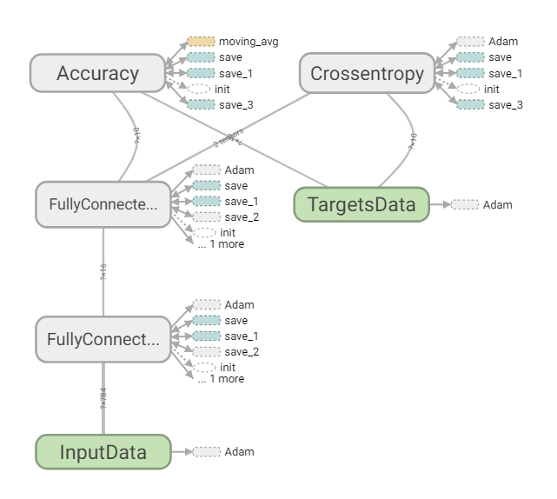
Notes:
Can also view computational graph

Slide 46
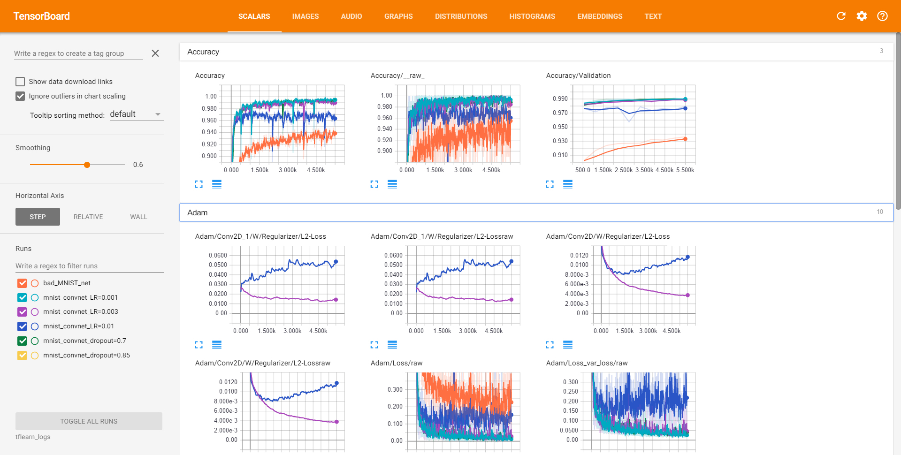
Notes:
Can visualise the training process

Slide 47
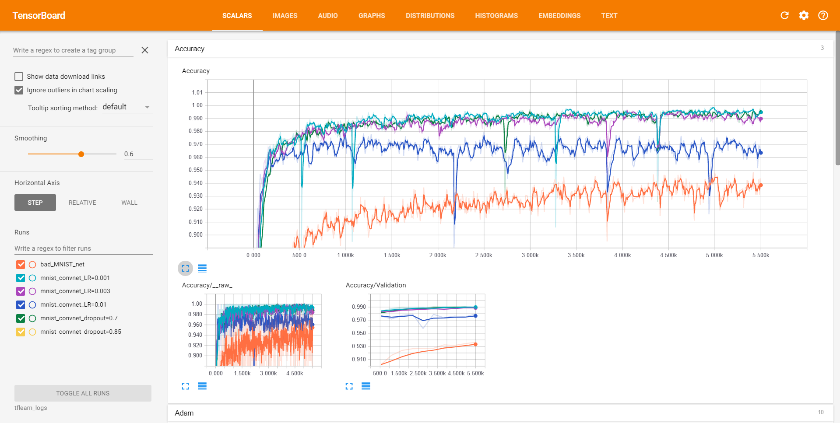
Notes:
Can visualise the training process – here are a bunch of models I’ve trained earlier

Slide 48
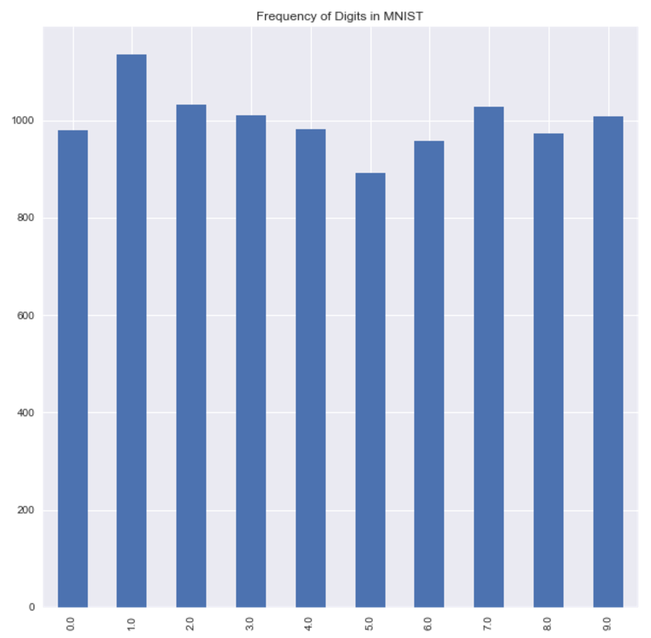
Notes:
Just emphasize that the distribution is uneven in the test set

Slide 49
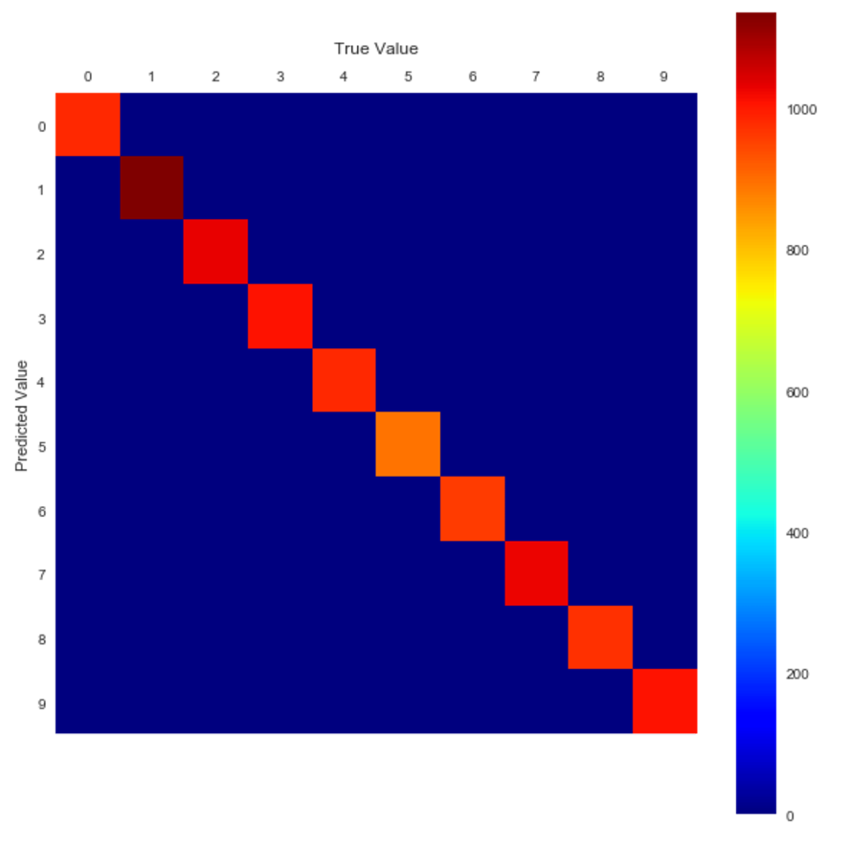
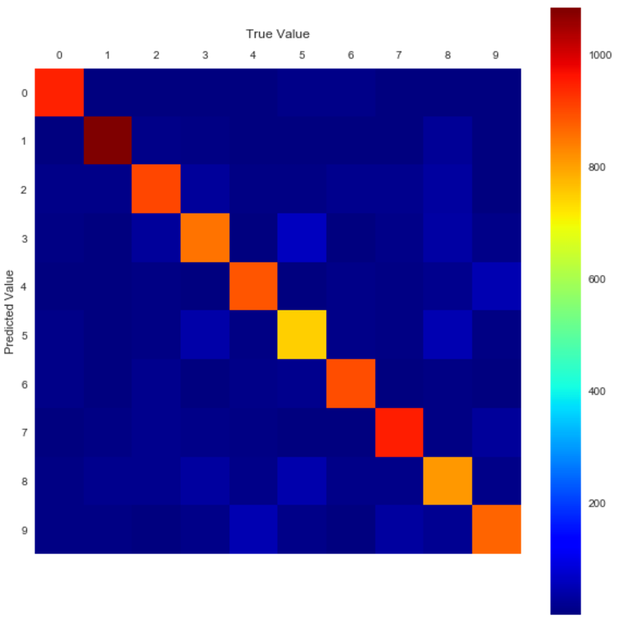
Notes:
Left image = perfect model
Right image = bad net result

Slide 50
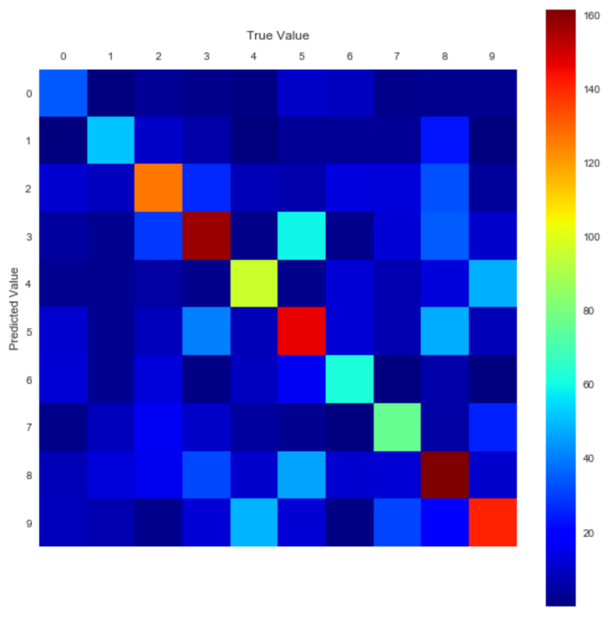
Notes:
This is the number of misclassifications in each bucket

Slide 51
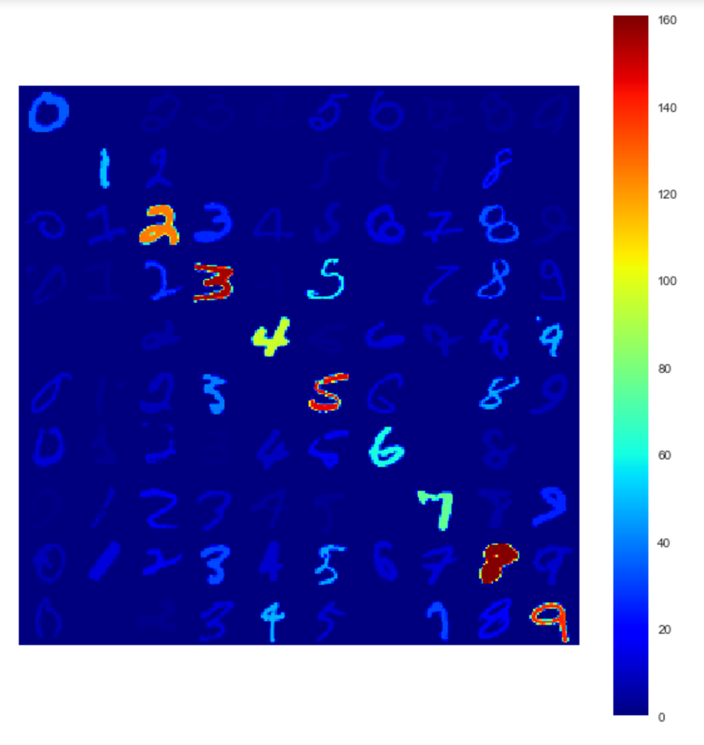
Notes:
We can skip to the end and have questions now, or I have another example

Slide 52
Extra Time: Convolutional Network Example
Here’s one I prepared earlier…

Slide 53
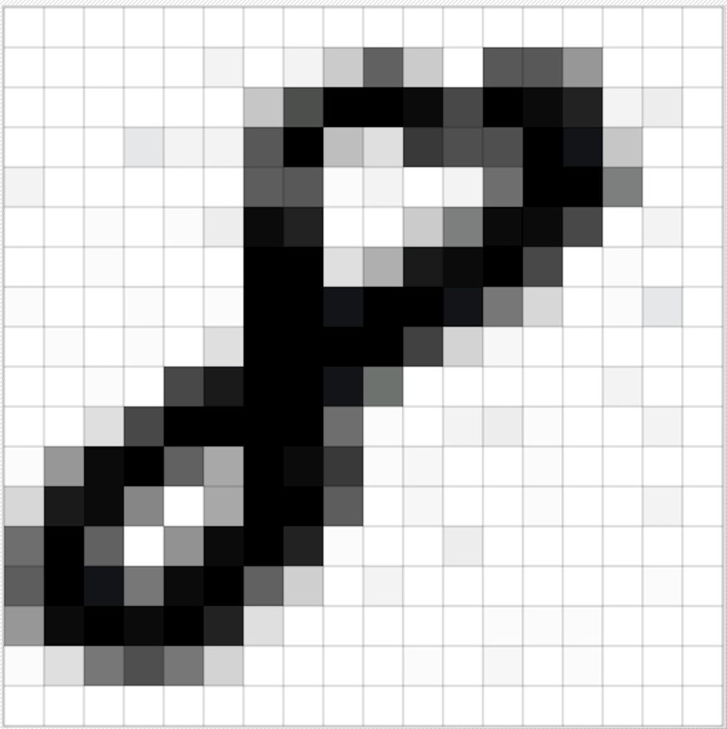
Notes:
A sample of the images – each image is 28x28 pixels, with pixel values that range from 0 to 1

Slide 54
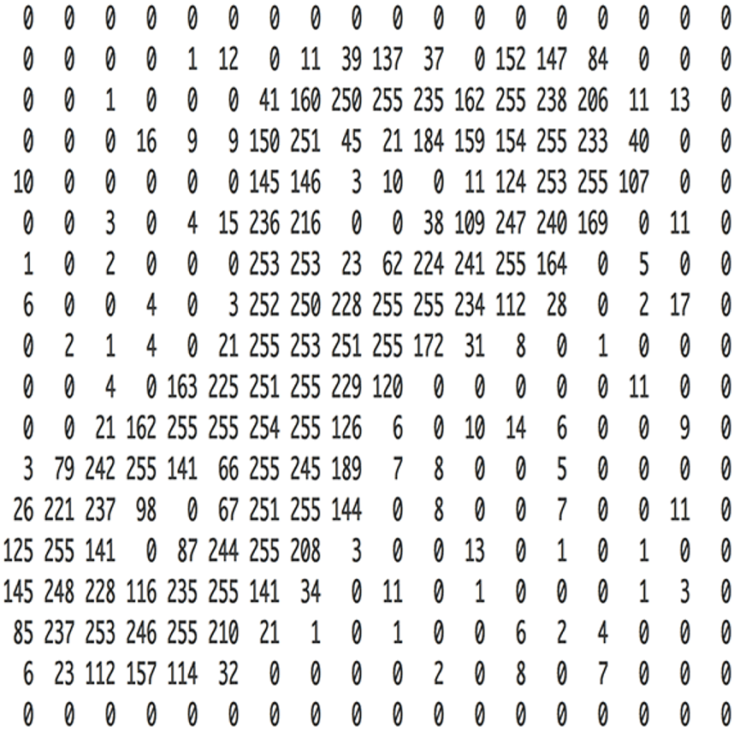
Notes:
A sample of the images – each image is 28x28 pixels, with pixel values that range from 0 to 1

Slide 55


Slide 56
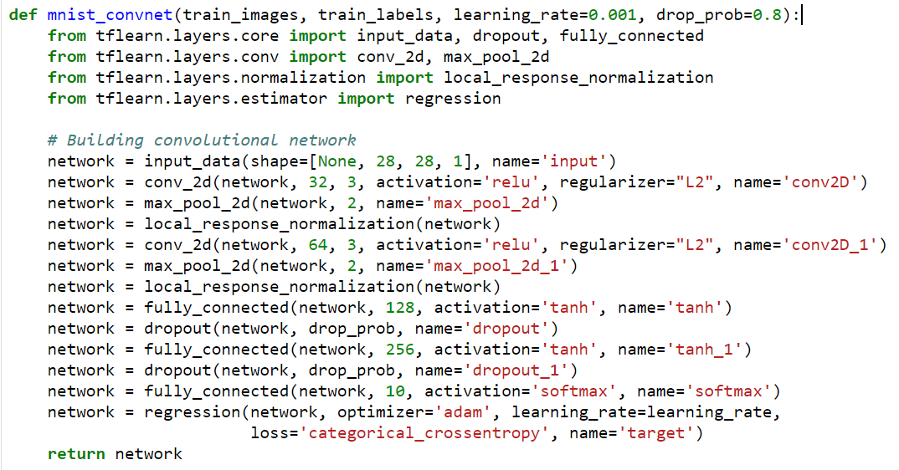

Slide 57
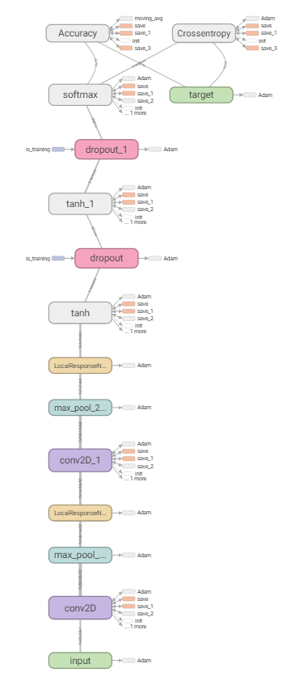
Notes:
This time the computational graph is more complicated

Slide 58
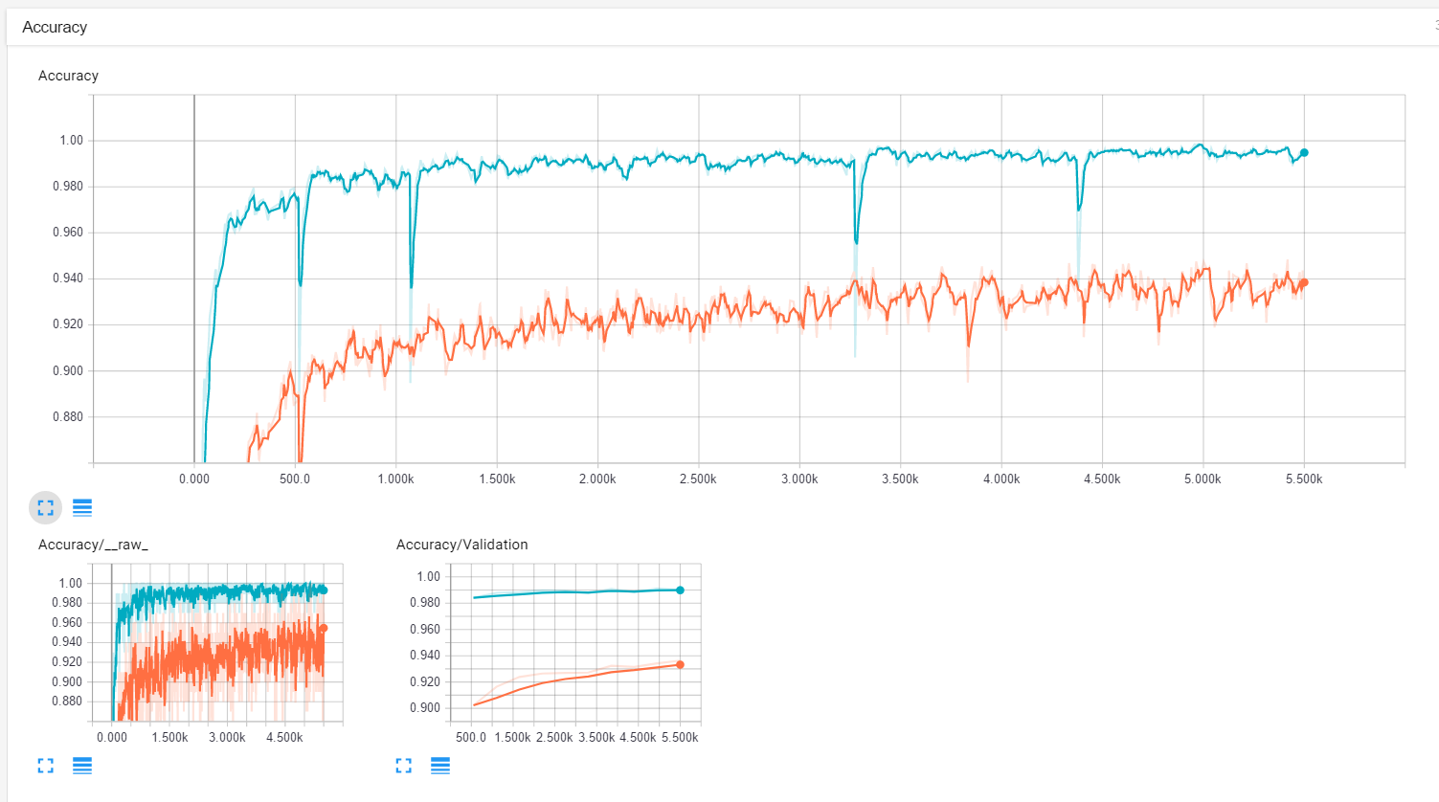
Notes:
Blue = convnet
Orange = badnet

Slide 59
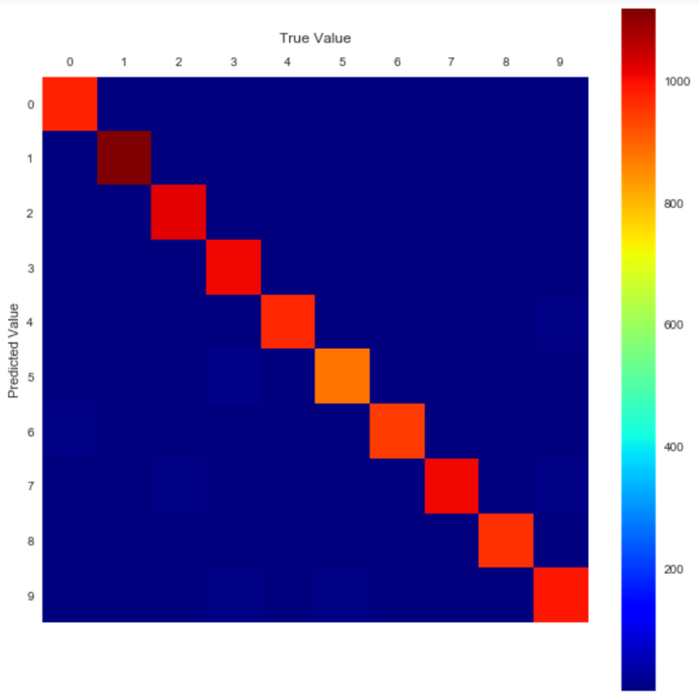
Notes:
Left image = bad net model
Right image = conv net

Slide 60
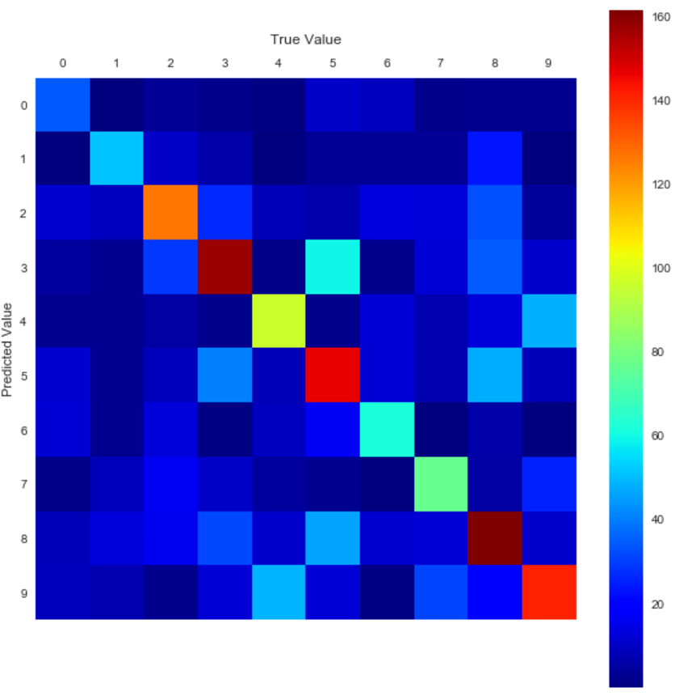
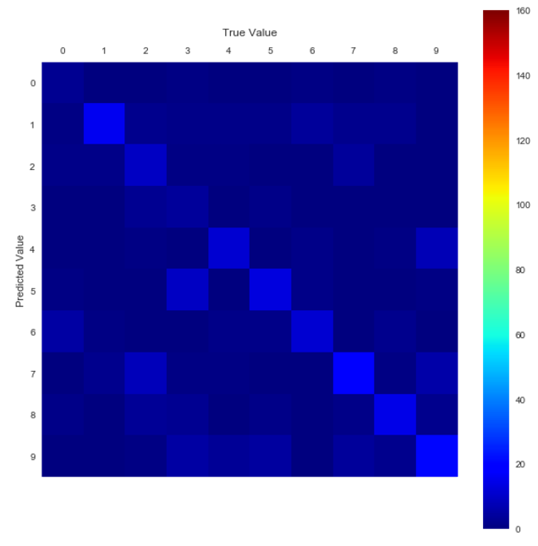
Notes:
Left image = bad net misclassification error
Right image = conv net result

Slide 61
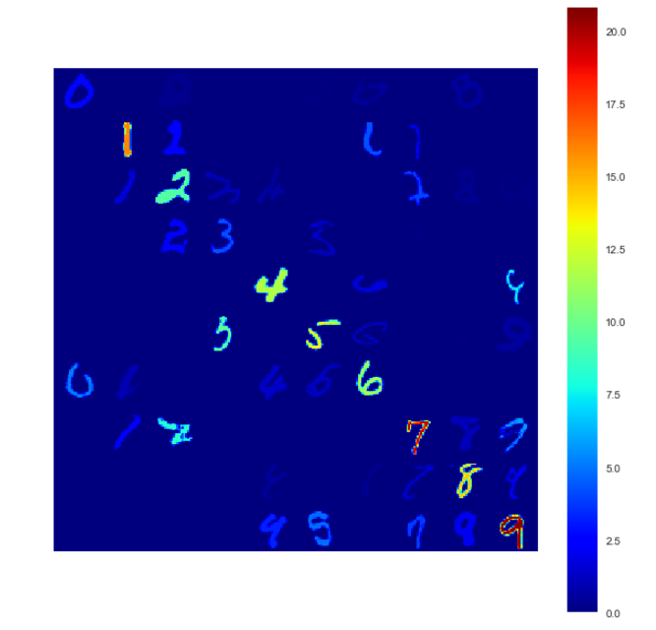
Notes:
Final result – the validation error of this model was 99.0% - the state of the art (I hear) is 99.7%

Slide 62
How to get started:
https://www.tensorflow.org/
http://tflearn.org/ - for Python users
https://keras.io/ - for Python or R users
https://www.kaggle.com/
“Tensorflow and deep learning - without a PhD by Martin Görner”: https://www.youtube.com/watch?v=vq2nnJ4g6N0
Notes:
Thank you very much

Slide 63
Other Links:
Images from:
https://medium.com/@ageitgey/machine-learning-is-fun-part-3-deep-learning-and-convolutional-neural-networks-f40359318721 (mnist digits as pixel values)
http://www.wildml.com/2015/11/understanding-convolutional-neural-networks-for-nlp/ (for convolution network animation)
https://www.youtube.com/watch?v=hDgXIUM3Rmw (for network model images)
https://demos.explosion.ai/similarity/?text1=This%20is%20another%20sentence&text2=How%20fast%20can%20a%20swallow%20eat%3F (Quora question deduplication example)
Recommended reading:
https://karpathy.github.io/2015/05/21/rnn-effectiveness/ (about recurrent neural networks)
https://www.youtube.com/watch?v=l4X-kZjl1gs&t=1528s (machine ethics)
https://www.youtube.com/watch?v=qv6UVOQ0F44&t=123s (reinforcement learning in Mario)
https://www.youtube.com/watch?v=Qy0oEkCZkBI&list=PLlJy-eBtNFt4CSVWYqscHDdP58M3zFHIG (Stanford Compsci 224 – Deep learning for language modelling)
Notes:
Thank you very much

Slide 64

Notes:
Thank you very much

